Slide 1
DTV Basic Features

Slide 2
Agenda
  What is Tele-text?
  Developments in Tele-text
  Close Caption and its styles
  EPG and its Features
  Return Path and its advantages/disadvantages
  PVR Overview and its Features

Slide 3
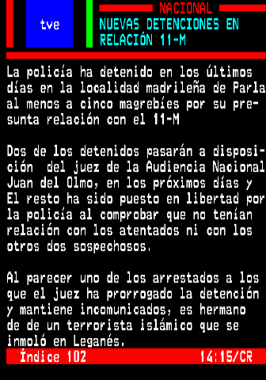
Tele Text
What Is Tele Text ?
Teletext (or "broadcast Teletext") is a television information retrieval service which offers a range of text-based information,
Features-
  Viewers can update with National, international and sporting news.
  weather forecasting and TV schedules.
  updated current affairs
  sport news.
  simple games (such as quizzes) .
  subtitling for deaf people or in different languages.

Slide 4
Tele Text
Technologies-
Teletext information is broadcast in the vertical blanking interval [VBI] between image frames in a broadcast television signal.
How Teletext Data Transmission happens ?
Following are the two types of Data Transmission
1. Directly from Network [Over the Air]
2. Stored in the Buffer memory
Directly from Network [Over the Air]-
Teletext uses a numbered page metaphor to present its information
It comprises one or more frames, each containing a screen-full of text.
The pages are sent out one after the other in a continual loop, When the user requests a particular page the decoder simply waits for it to be sent, and then captures it for display, In order to keep the delays reasonably short, services typically only transmit a few hundred frames in total.

Slide 5
Tele Text
Stored in the Buffer memory-
Television sets, with built-in memory, stores the teletext sent out and stores it in memory, so when a page is requested by the user it can be loaded directly from memory instead of having to wait for the page to be transmitted.
When the page is transmitted again, the television checks if the page in memory is still up-to-date and updates it if necessary.
Decoders Used -
The type of decoder circuitry is sometimes marked on televisions as
  CCT (Computer Controlled Teletext)
  ECCT (Enhanced Computer Controlled Teletext).

Slide 6
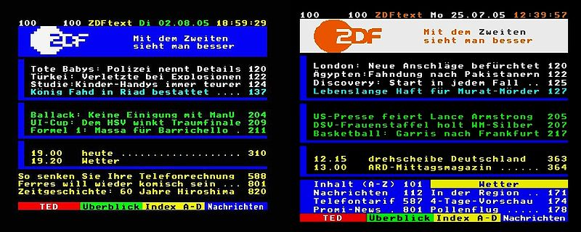
Later developments On Tele text
Following are the improvements have been made on the top of basic teletext.
Standard Electronic Programme Guides (EPG), are based on teletext, using a compact binary format instead of preformatted text pages.
Level 2.5 teletext / Hi-Text
  In Teletext 2.5, it is possible to set a background color and have higher resolution text and images.
Comparison between Teletext Level 1.0 and Teletext Level 2.5.

Slide 7
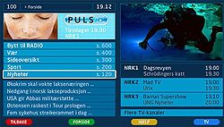
Later developments On Tele text
Digital teletext-
This is also known as MHEG and Multimedia Home Platform

Slide 8
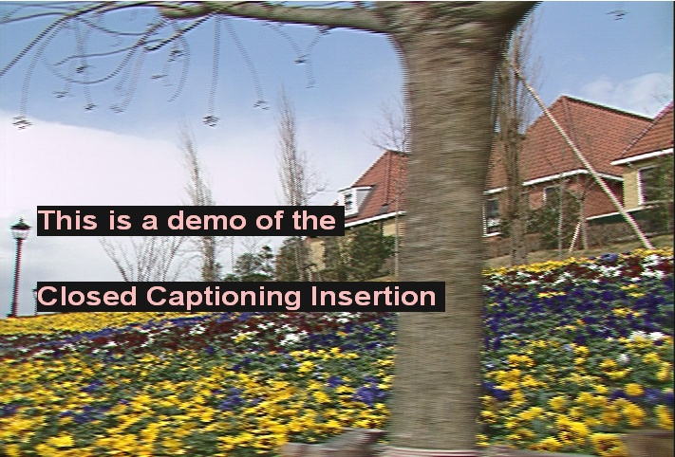
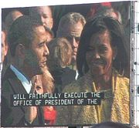
Close Caption
Closed captions typically display a transcription of the audio portion of a program as it occurs , sometimes including non-speech elements.
Difference between Subtitles and Captions
"subtitles" assume the viewer can hear but can not understand the language, so they only translate dialogue and some on-screen text, there will be no audio content
"Captions" assume the viewer can not hear and describe all significant audio content
— Spoken dialogue and non-speech information such as the identity of speakers and their manner of speaking
— Music or sound effects using words or symbols.

Slide 9
Close Caption
Terminology
There are two types of Captions
1. Close Caption
2. Open Captions
Close Caption-
“Closed” in closed captioning indicates that not all viewers see the captions — only those who choose to decode or activate them.
Mostly Used by deaf or hard of hearing individuals to assist comprehension or in an environment where the audio is difficult to hear or is intentionally muted.
Captions can also be used by viewers who simply wish to read a transcript along with the program audio, Musical notes.
Open Captions-
This is also known as burned-in or hardcoded captions, which are visible to all viewers.

Slide 10
Style Of Close Captions
There are three styles of closed captioning-
Roll-up or scroll-up or scrolling:
The words appear from left to right, when a line is filled, the whole line scrolls up to make way for a new line, and the line on top is erased.
Use: for live events, where a sequential word-by-word captioning process is needed.
Pop-on or pop-up or block:
caption appears anywhere on the screen as a whole, followed by another caption or no captions.
Use: This method is used for most pre-taped television and film programming.
Paint-on:
The caption, whether it be a single word or a line, appears on the screen letter-by-letter from left to right, but ends up as a stationary block like pop-on captions.
Use :Rarely Use ,most often seen in very first captions when little time is available to read.

Slide 11
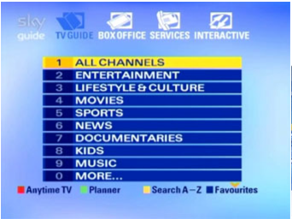
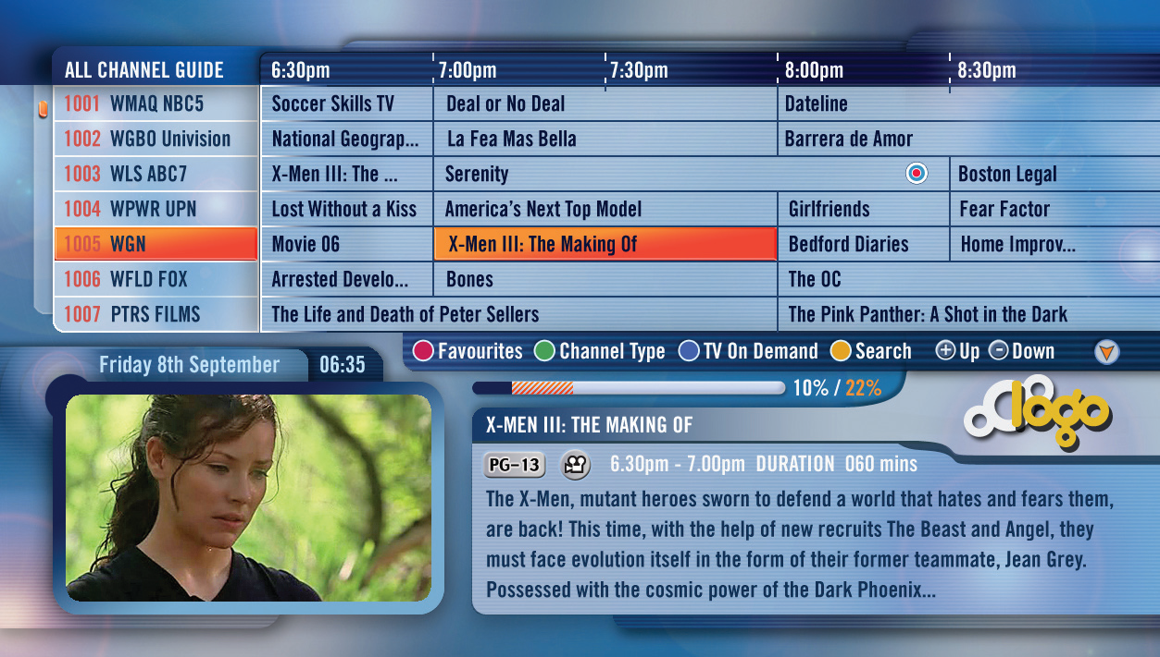
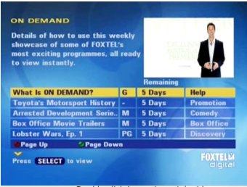
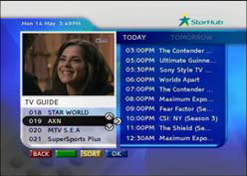
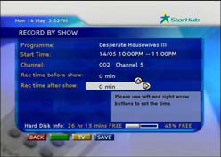
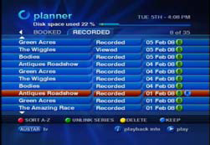
EPG [Electronic Programme Guide]
An electronic program guide (EPG) is an on-screen listing of television programs, similar to the TV listings in your local newspaper.
Menus are provided that allow the user to view a list of programs scheduled for the next few hours up to several days in advance.

Slide 12
Features of EPG
EPG is accessed using a remote control.
Features Supported :
  Parental control rating display for the events.
  Order pay-per-view programming
  Programs searching based on Genre [E.g. Theme ,category, Date & Time ]
  Set the recordings for the programs.

Slide 13
Return Path
A return path will allow content providers to offer viewers a new range of applications for example-
  Voting
  Games
  Chat-like services (allowing viewers to send in comments and opinion)
  Interactive transactions for purchasing goods and services.
  It opens up the possibility of more advanced interactive services to enable data or streamed audio/video to be delivered over the broadband path.
How It’s Works?
  A return path could be set up between the set-top decoder and the Subscriber Management System using a modem and the telephone network or a cable TV return. For example, calls could be initiated by the customer using a remote control unit which auto-dials a number delivered over-air. Also, the broadcaster
  may want the customer’s decoder box to contact the SMS. This process could be initiated by commands sent over-air or (less likely) the SMS could
  dial up the customer’s decoder box and interrogate it directly.

Slide 14
Advantages/Disadvantages
Advantages
Enhanced security
Payment billing
Interactive TV
Transmission of entitlement messages
Disadvantages
Increased decoder cost
Installation difficulties
Blocking of normal calls

Slide 15
What is PVR?
  A personal video recorder (PVR) is a device that records video in a digital format to a disk drive or other memory medium within a device.
  The term includes stand-alone set-top boxes, portable media players (PMP) and software for personal computers which enables video capture and playback to and from disk.
  PVR Also Known as Digital Video Recorder [DVR].
  How It Works?
  Recording digital signals is generally a straightforward capture of the binary MPEG data being received.
  No expensive hardware is required to quantize and compress the signal (as the television broadcaster has already done this in the studio).

Slide 16
PVR Overview
Video compression removes information in exchange for a smaller file size.
Increasing compression leads to the ability to store longer periods on a disk, at the expense of sacrificing some of the detail in the images.
This trade-off must be considered when attempting to balance image quality and recording time in a DVR. As storage drives become cheaper and larger, compression sacrifices are improving.
DVB Digital television contains audio/visual signals that are broadcast over the air in a digital rather than analog format. The DVB data stream can be directly recorded by the DVR.
By using the Common Interface of the CA system, It could be possible to descramble two channels on the same multiplex (one to watch and the other to record), using one PCMCIA module.
To descramble two channels on different multiplexes, one would need two PCMCIA modules I,e two tuners and two MPEG-2 decoders.

Slide 17
PVR Features
PVR Features :
Audio ,Video & data content recording of both FTA & Scrambled channel.
Playback the recorded contents from disk drive [Eg. Hard disk].
Various types of Recording options,
  Normal Playback
  Time-Shift Recording
  Timer Recording
  EPG Timer Recording
  Dual Recoding [In Case of Dual Tuner]
  Frame Capture

Slide 18
PVR Features
Various types of playback options,
    Normal Playback
    Shuffle playback
    Random Playback
    Intro playback
    Fast Forward Playback
    Fast Backward play back
    Slow Forward Playback
    Slow Backward play back
    Go to Play back
    Slide Show

Slide 19


